Slide 1



ANNUAL GENERAL MEETING 2025
3rd December 2025 7pm @ Steel Bones HQ

Slide 2

AGENDA
Welcome by our Chair, Gary Hawksworth
Apologies
Presentation of Annual Report from our Chair
Adoption of Annual Report
Presentation of Accounts from Bank Account from Trustees, Billie Lawler and Adam Tilbrook
Adoption of Accounts
Trustee, Chair, Treasurer Stand down and appointment
Discussion on Website Advertising
Any other Competent Business
Closing Remarks

Slide 3
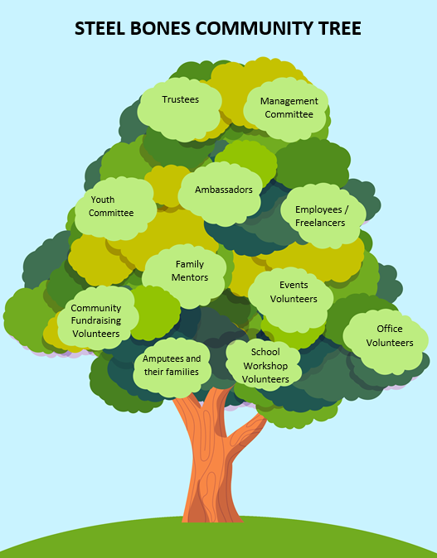



Notes:
This is the structure of Steel Bones, we don’t like hierarchy and this should eb flipped upside down as the amputee families guide us in all our activities. However, of course, our trustees are entirely responsible for financial control and safeguarding. The team is ever growing and we are always looking for more volunteers to help us cope with demand and new Committee Members.
You will see we rely heavily on volunteers, they are the lifeblood of Steel Bones. Ut started as a voluntary organisation and these volunteers remain at the heart of decision making and all we do. Supported by 1.5 employees currently. We keep costs down as much as possible with team working from home to ensure the organisation runs safely and professionally as scrupulously as possible.

Slide 4
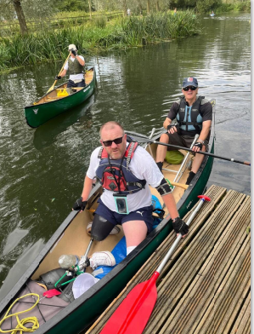
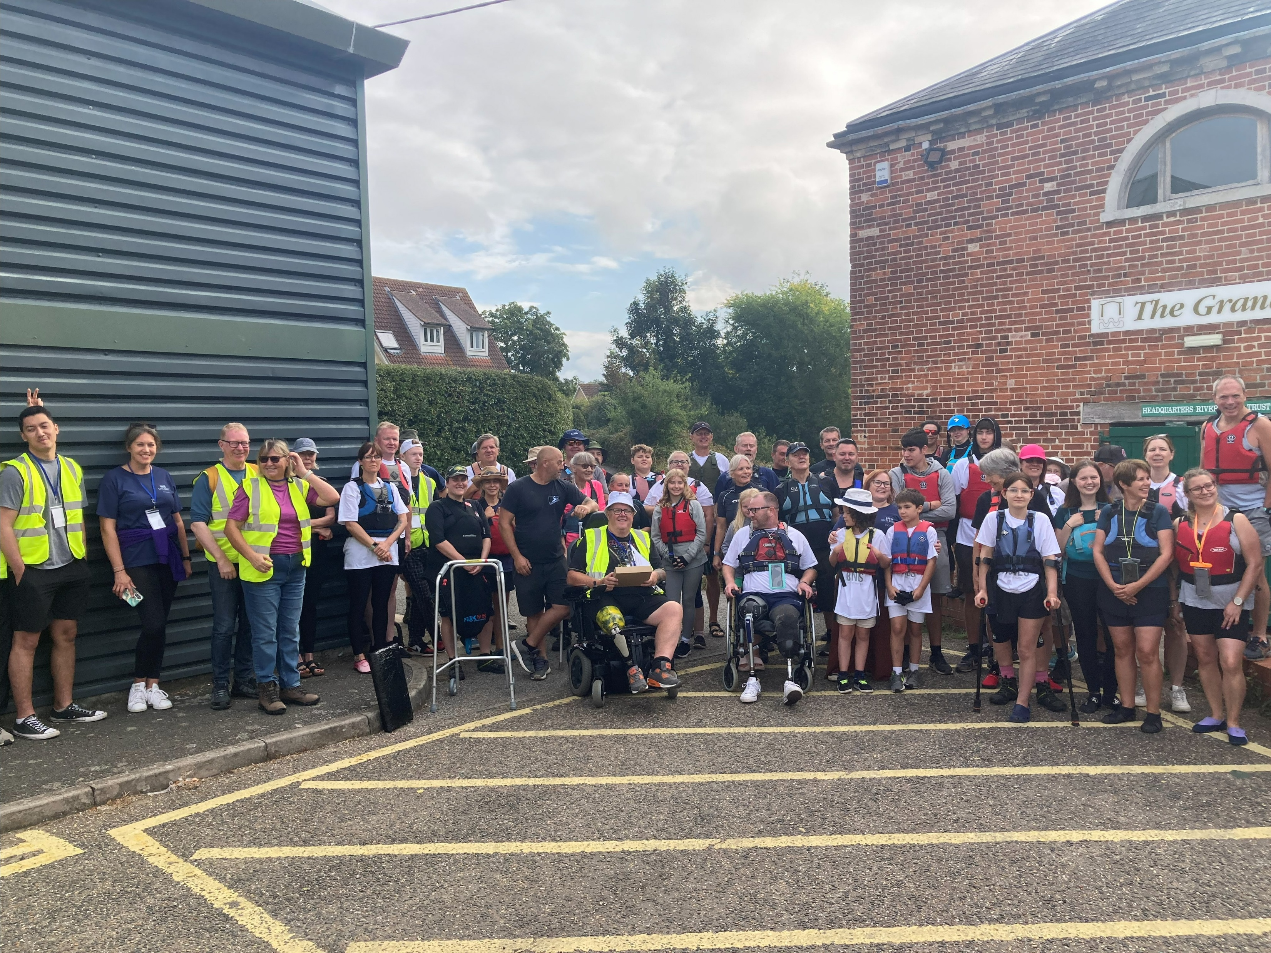
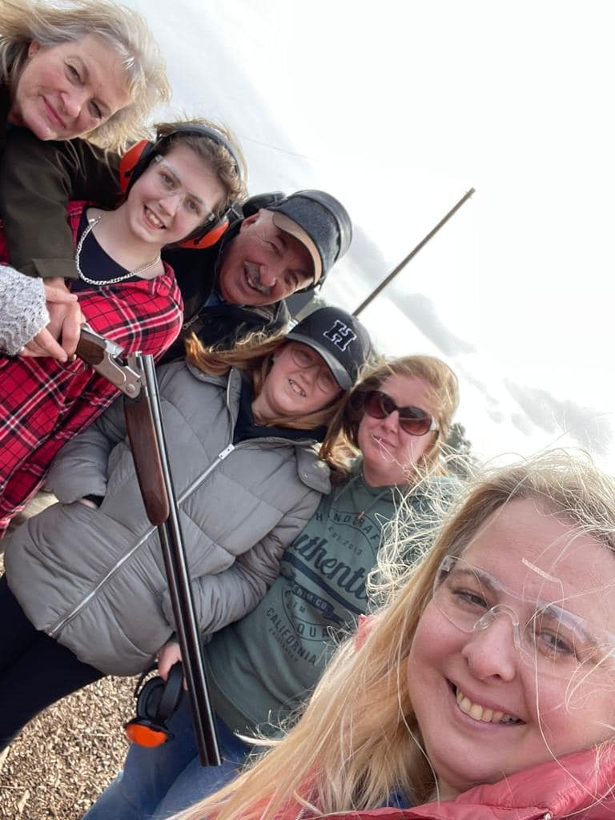
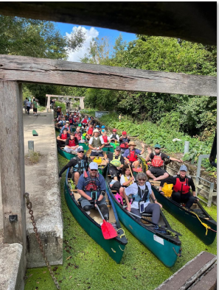
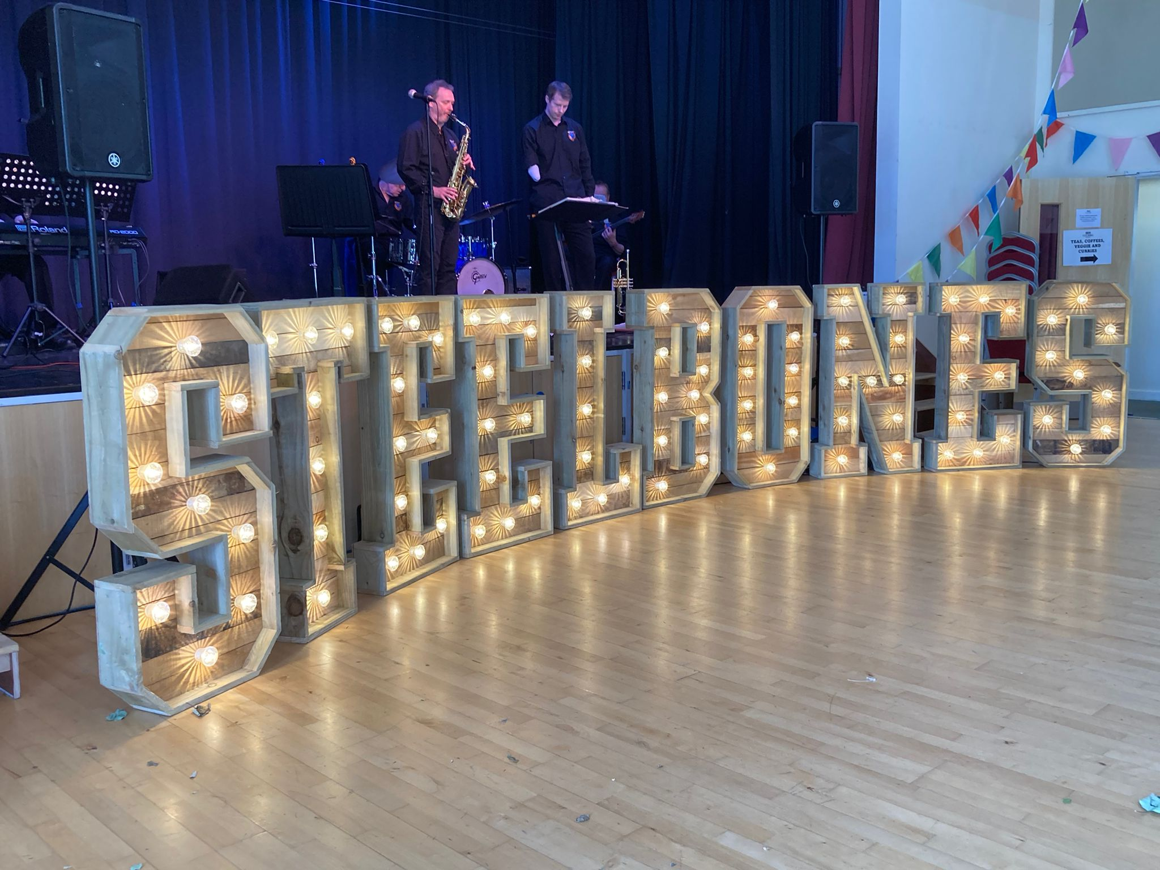
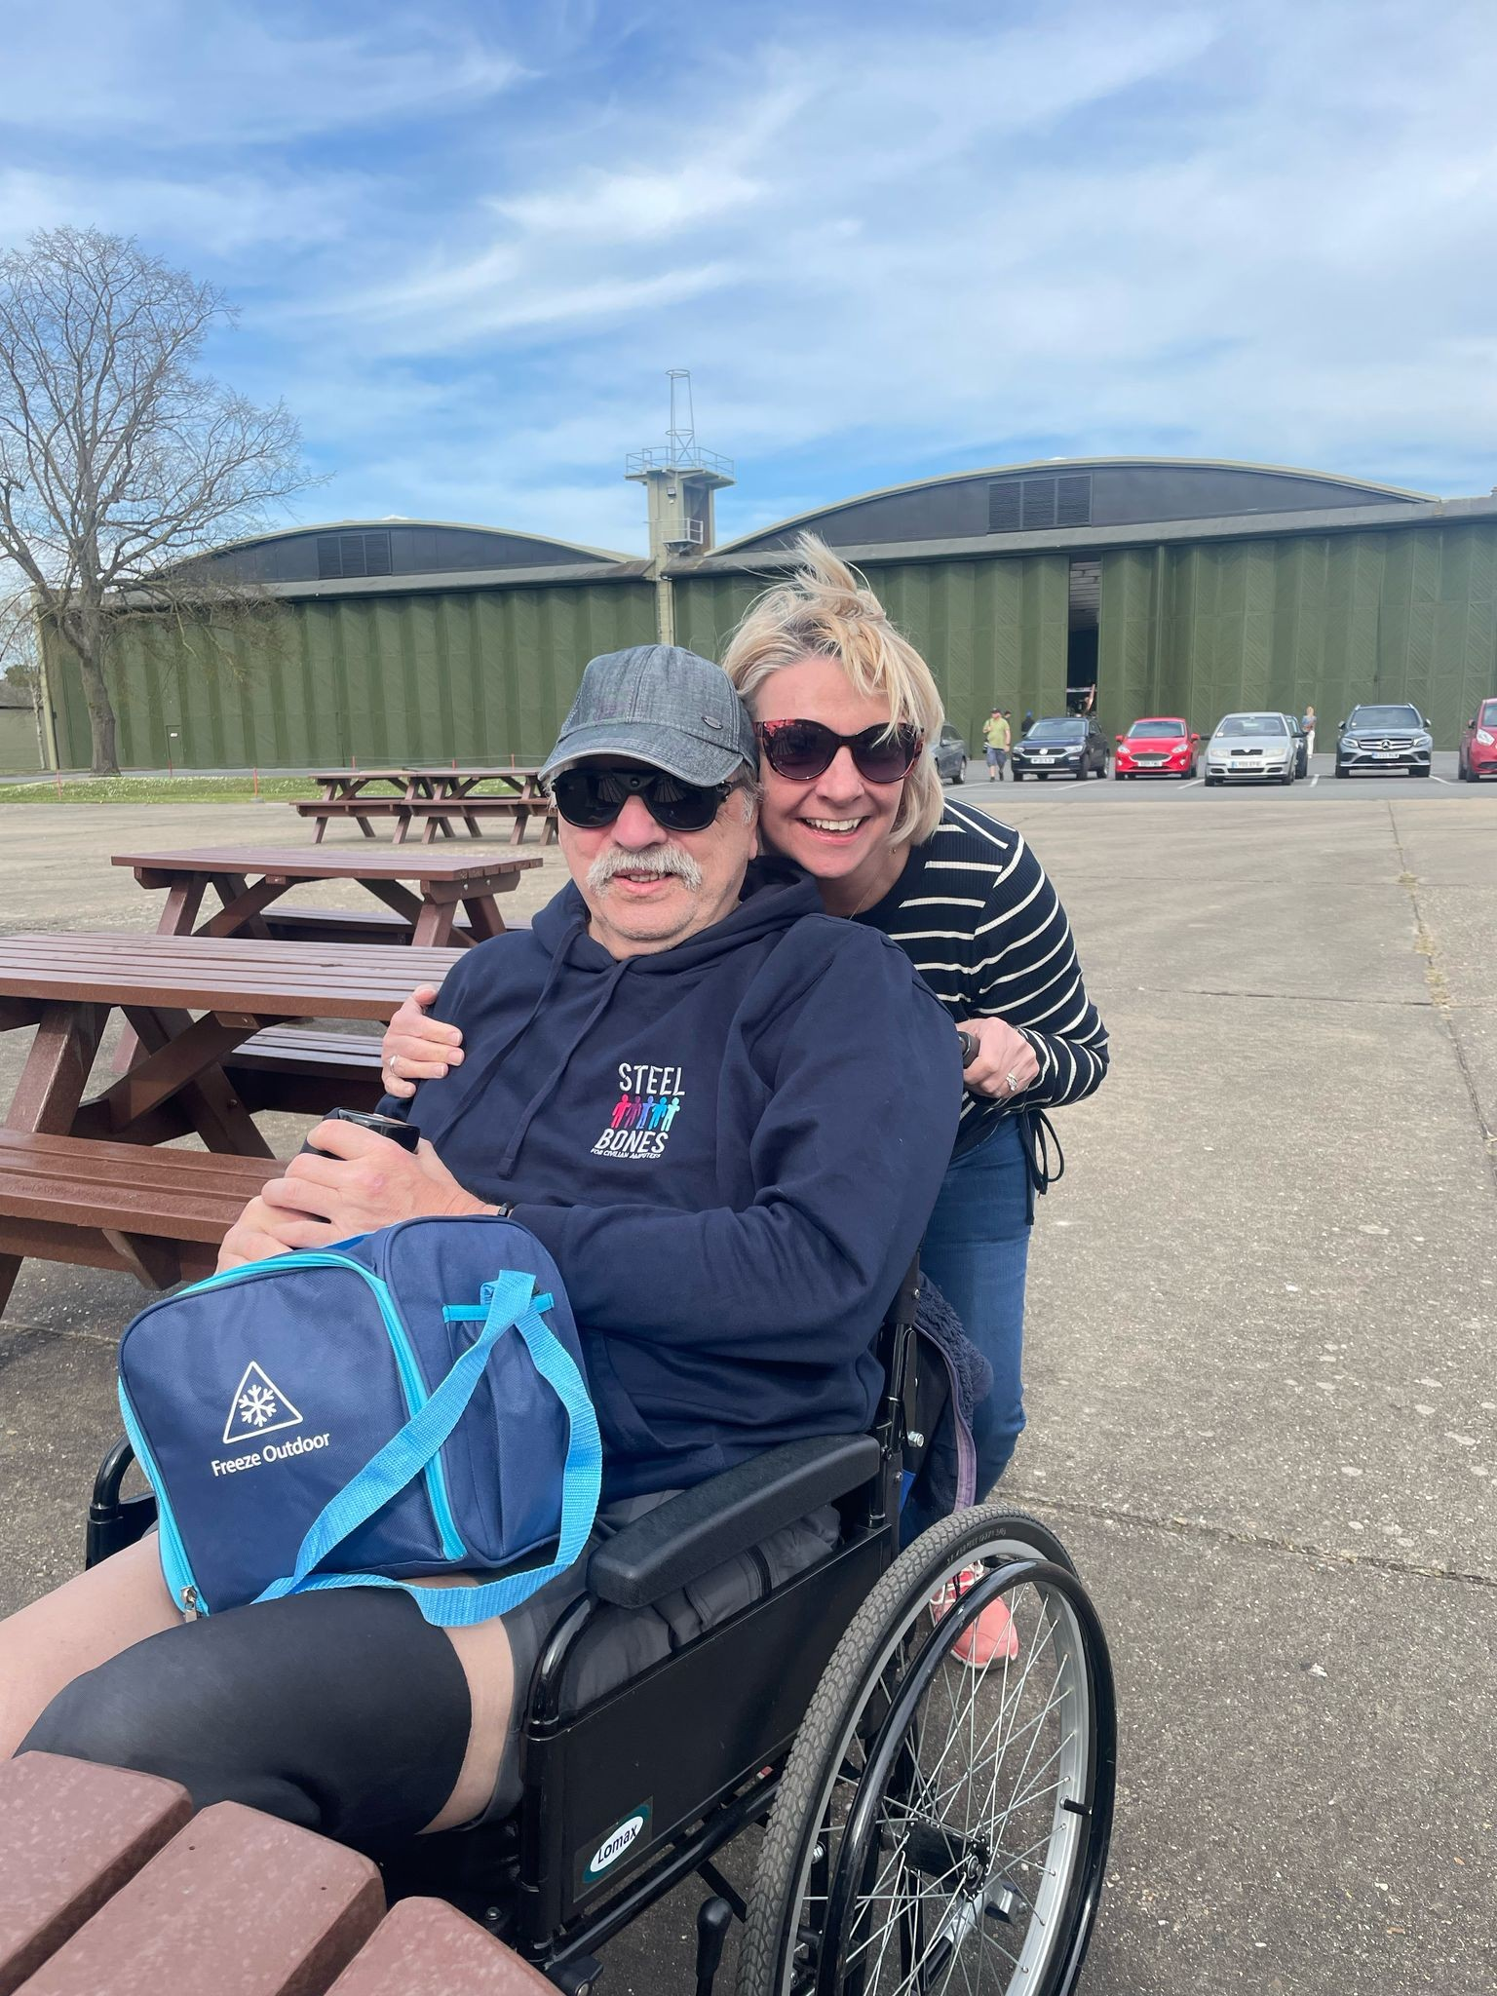
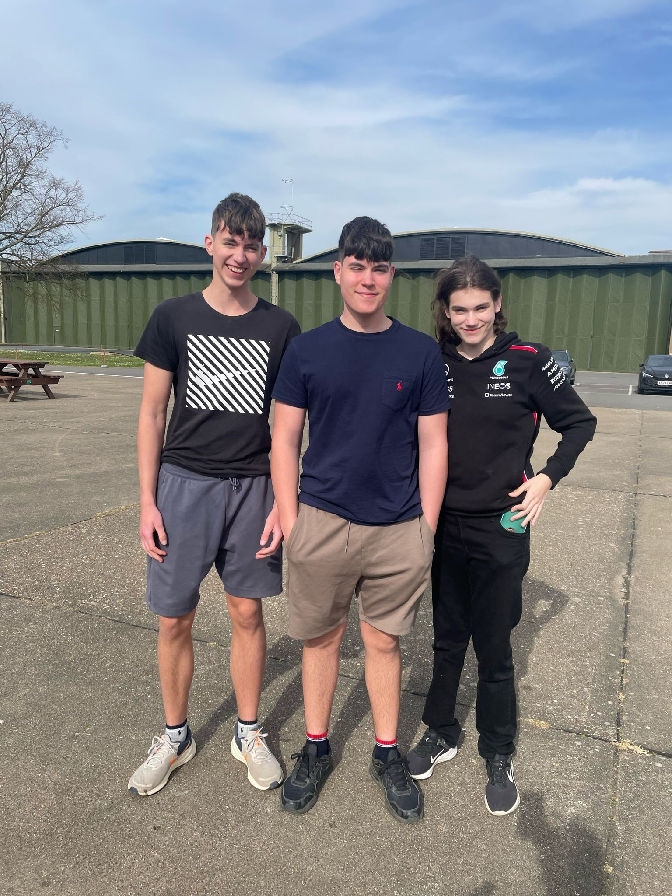
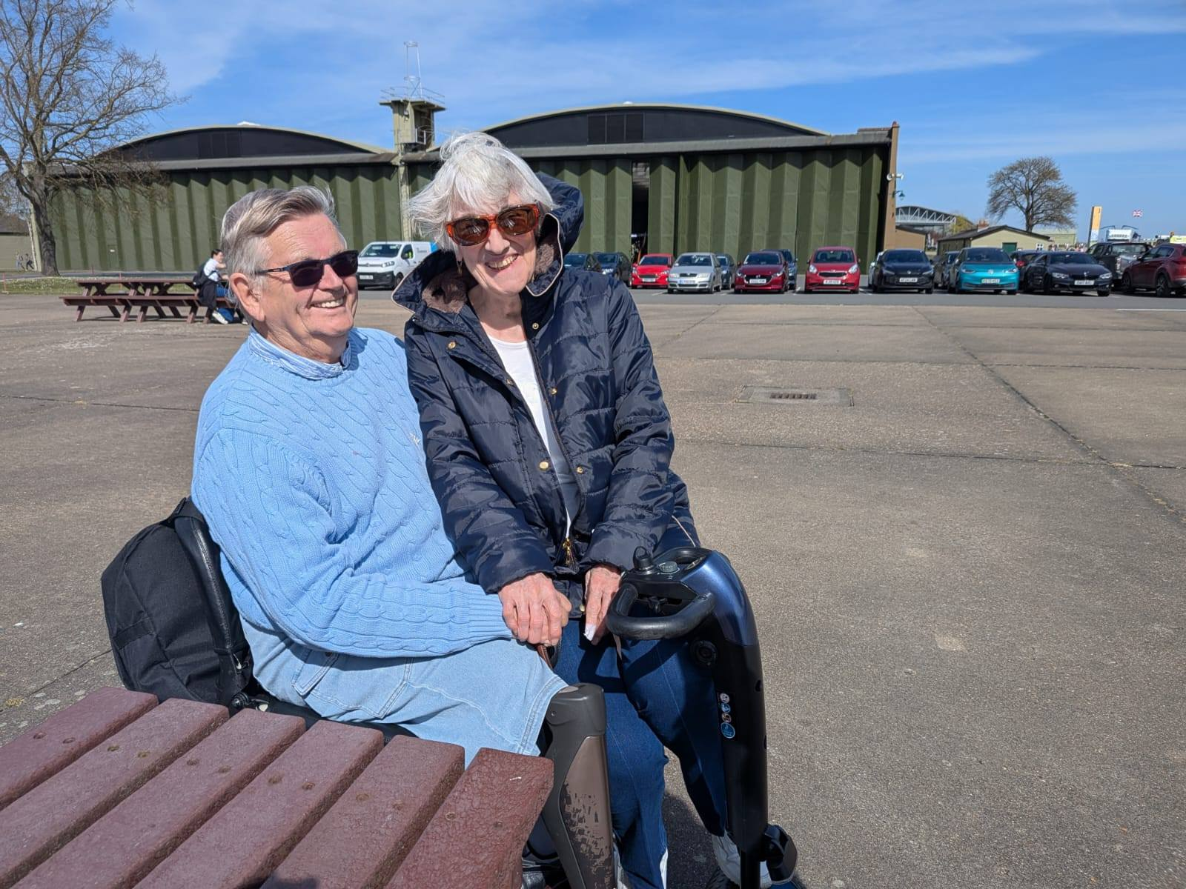
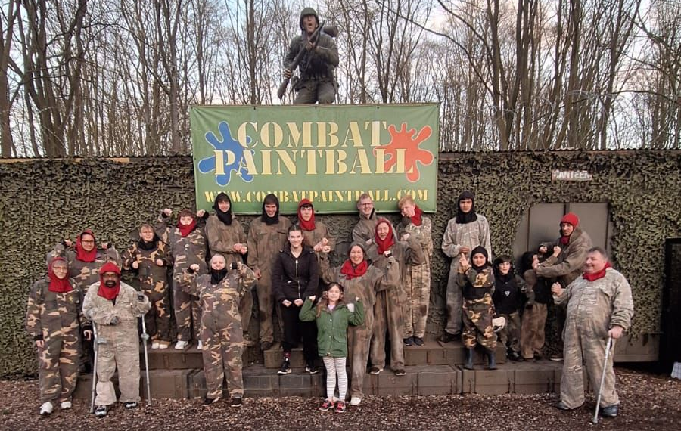
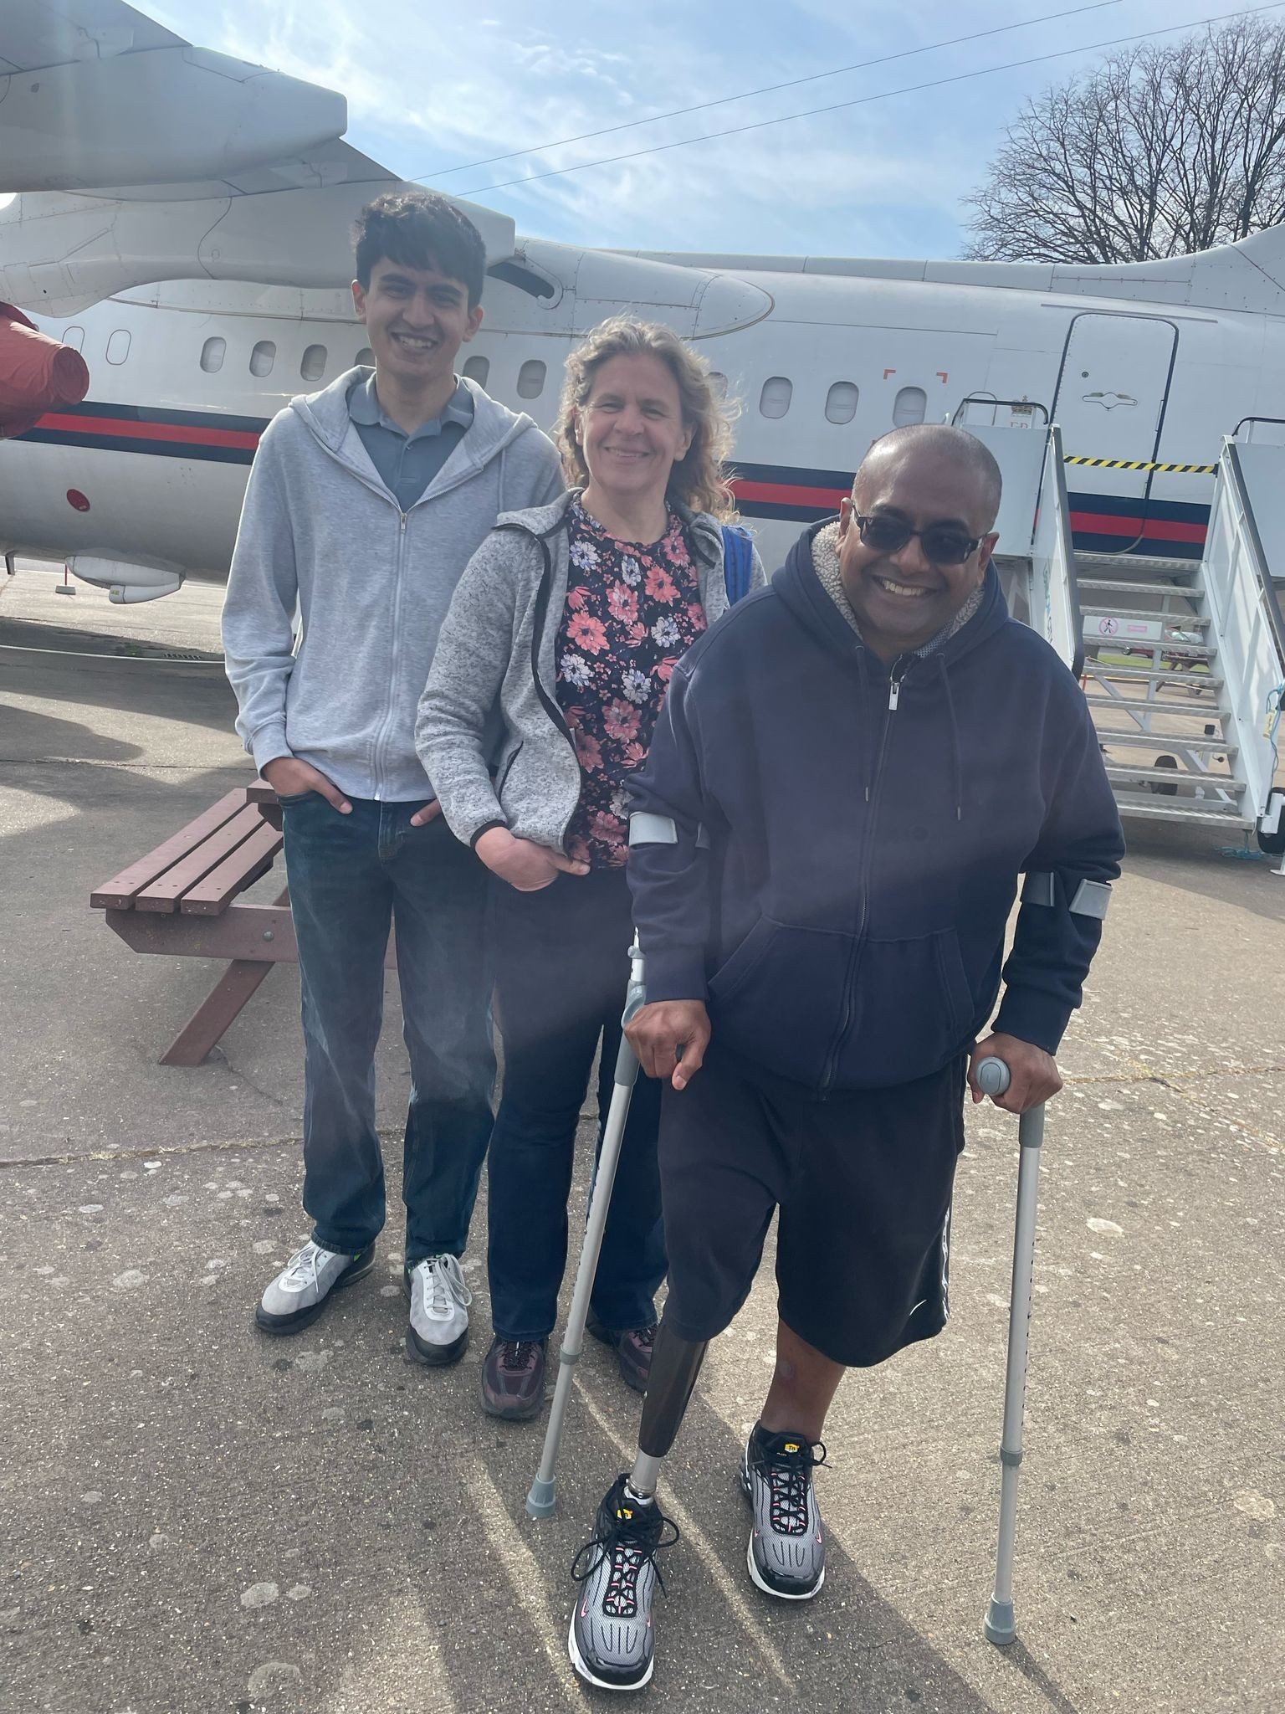
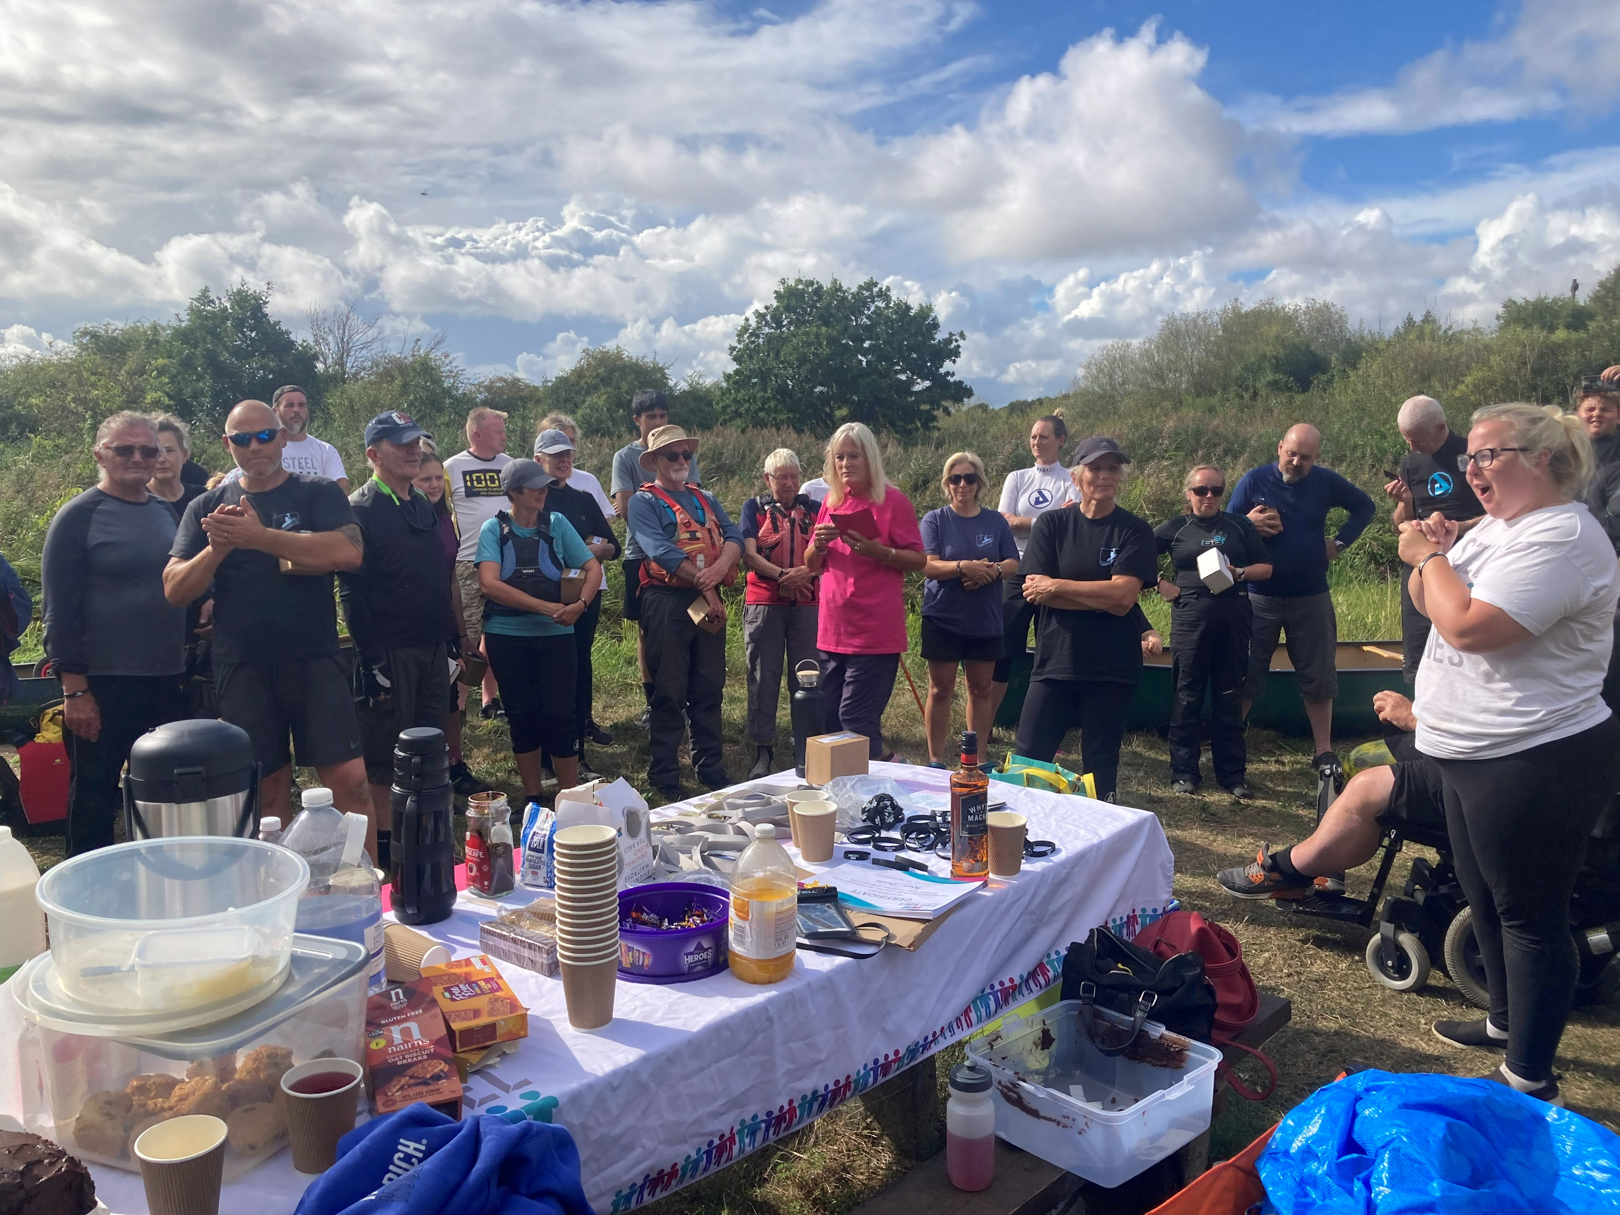
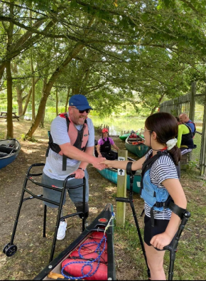
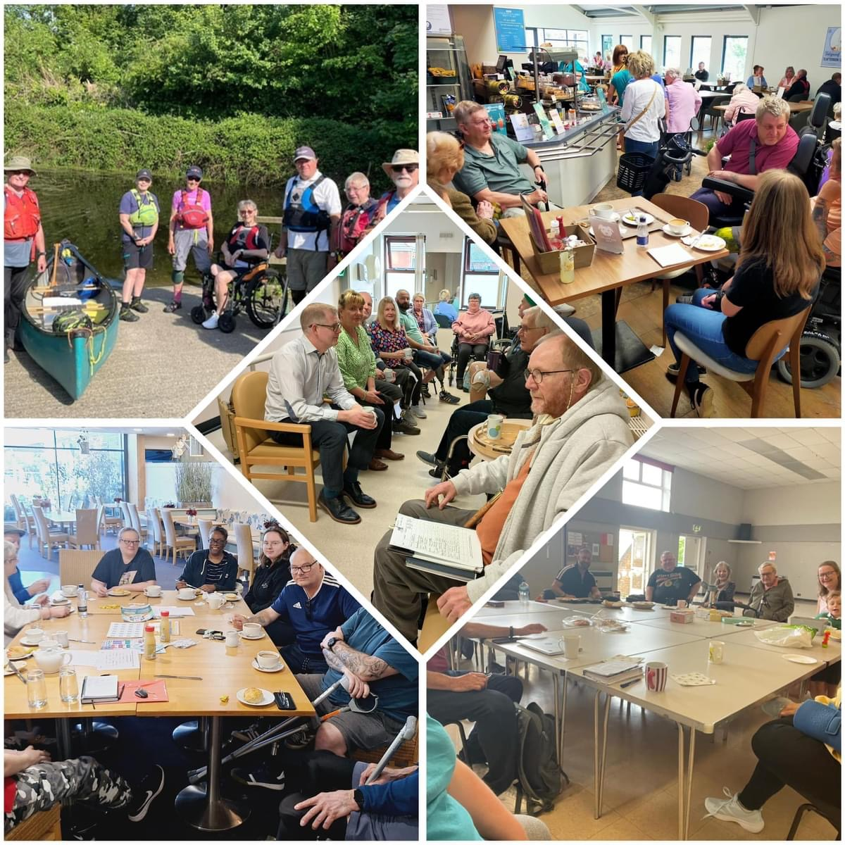
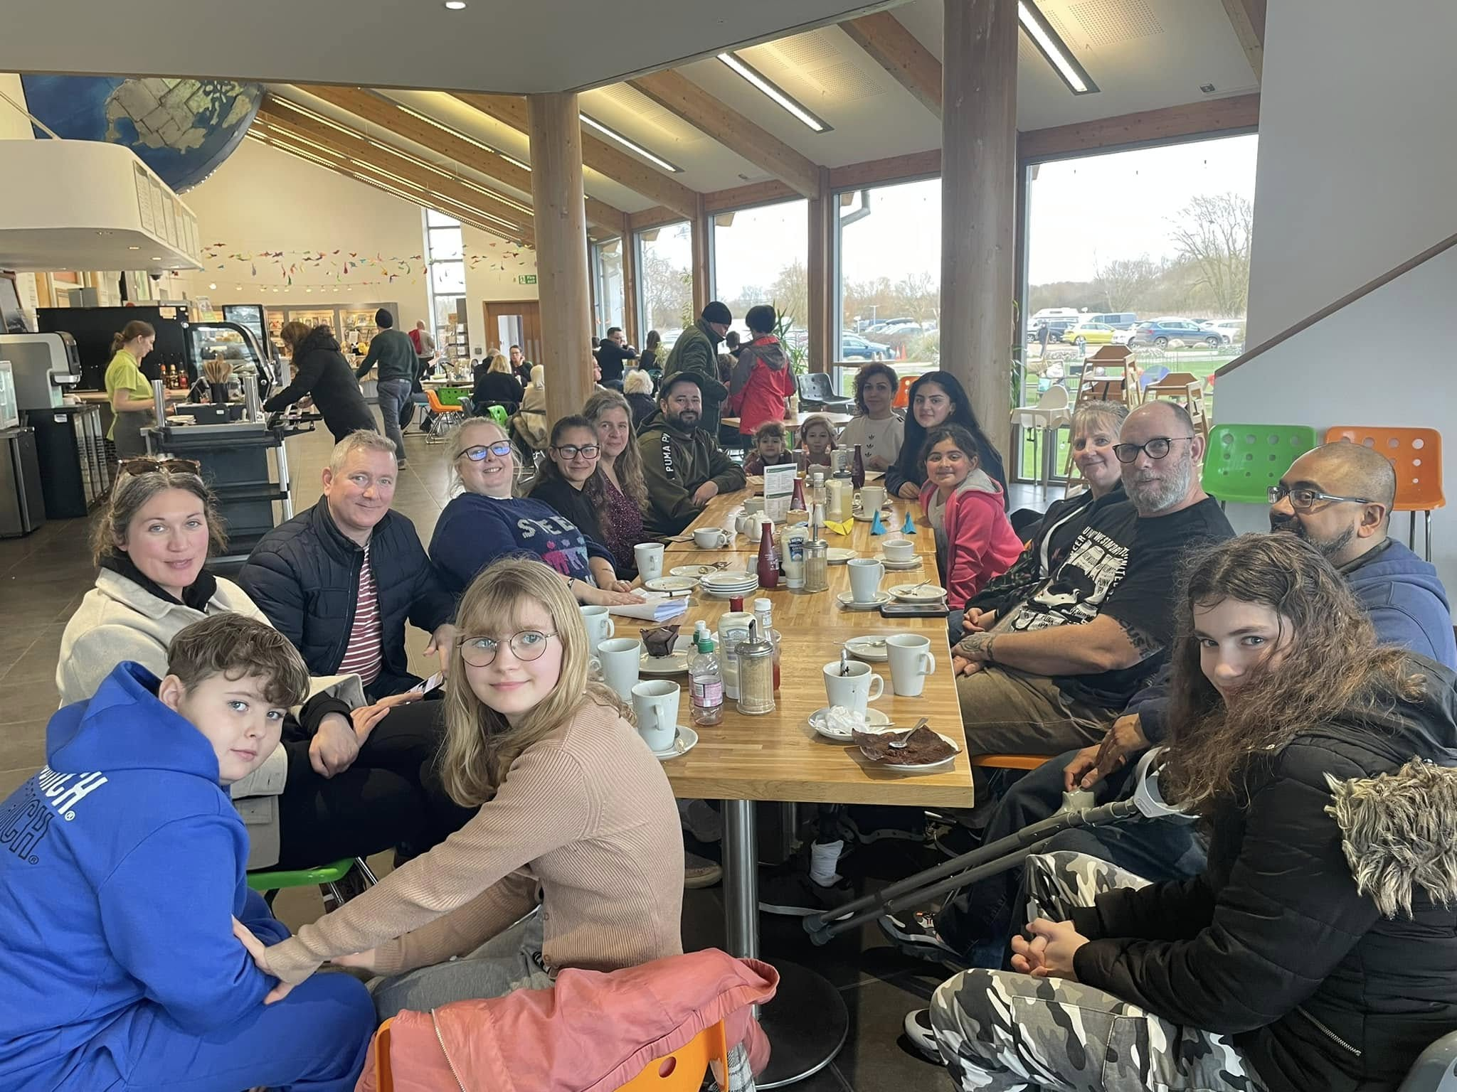
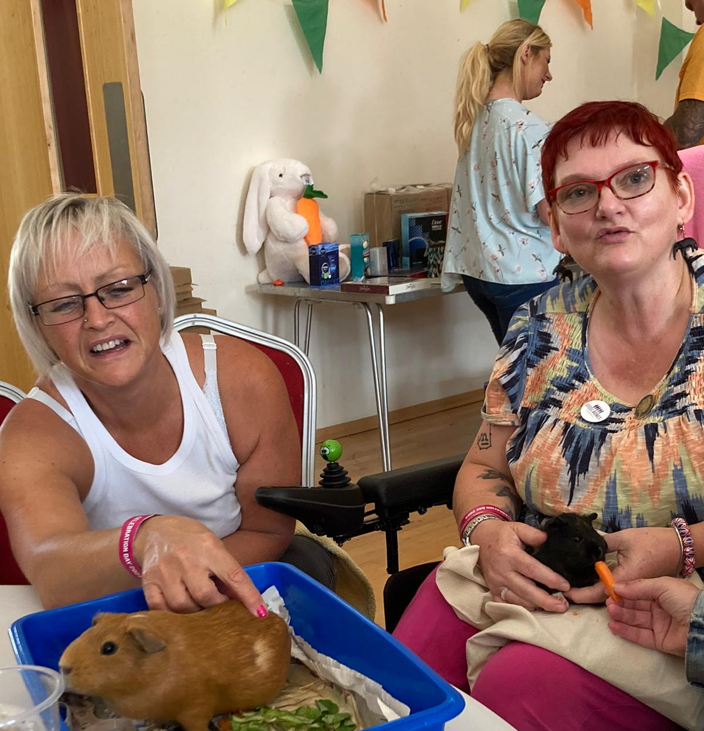
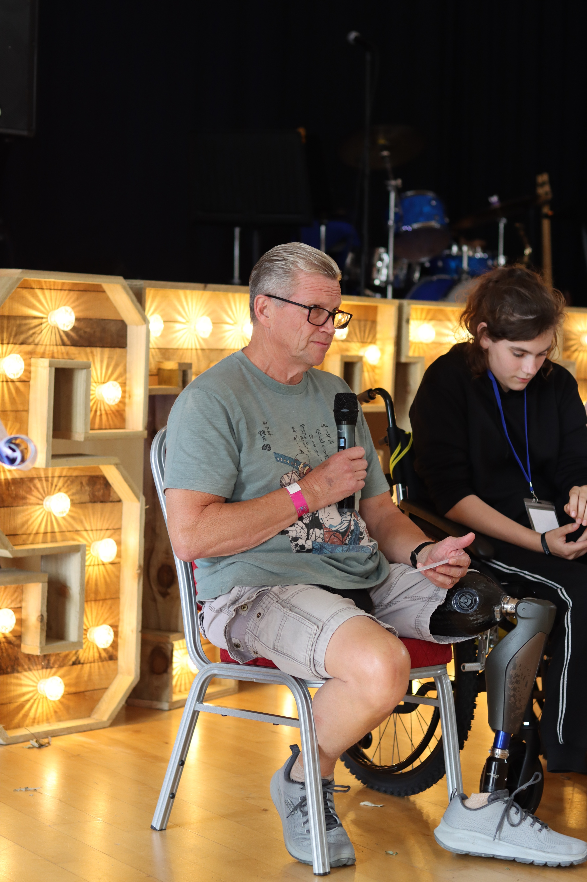

Slide 5
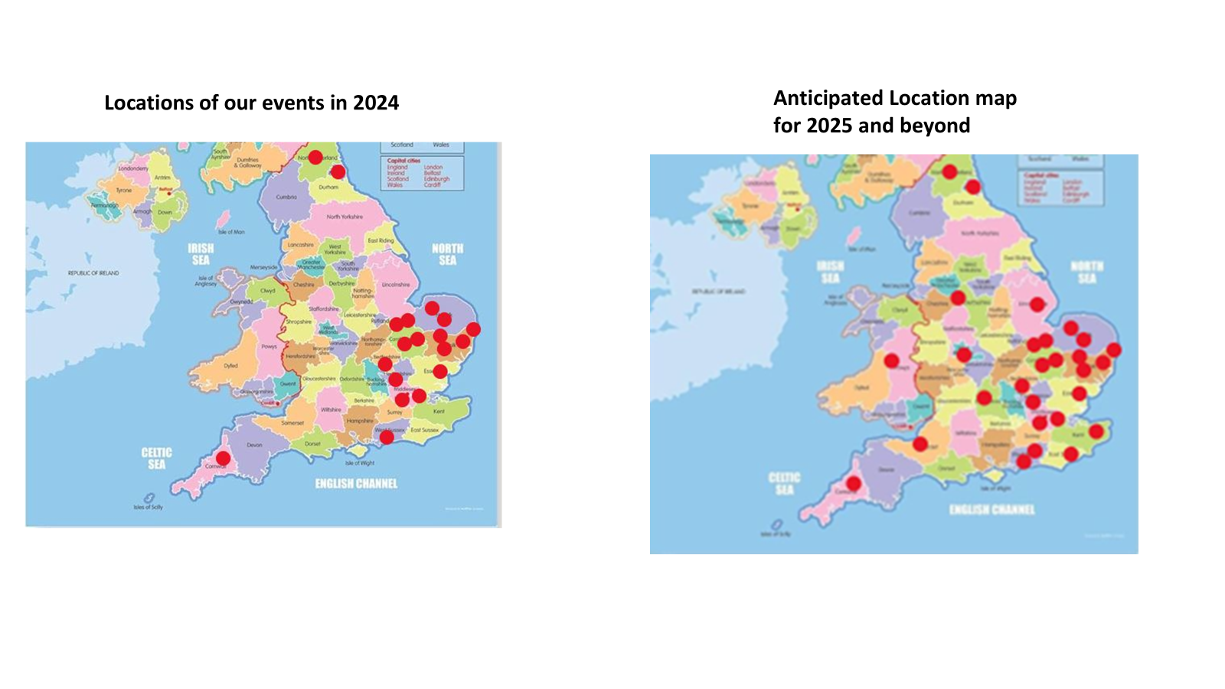
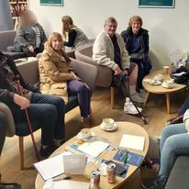
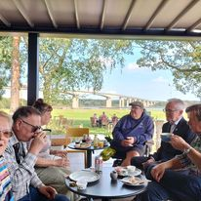
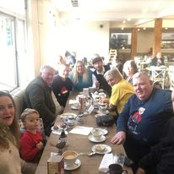
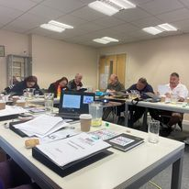
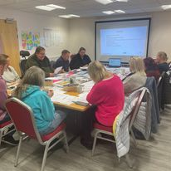
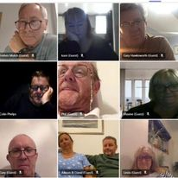

Slide 6
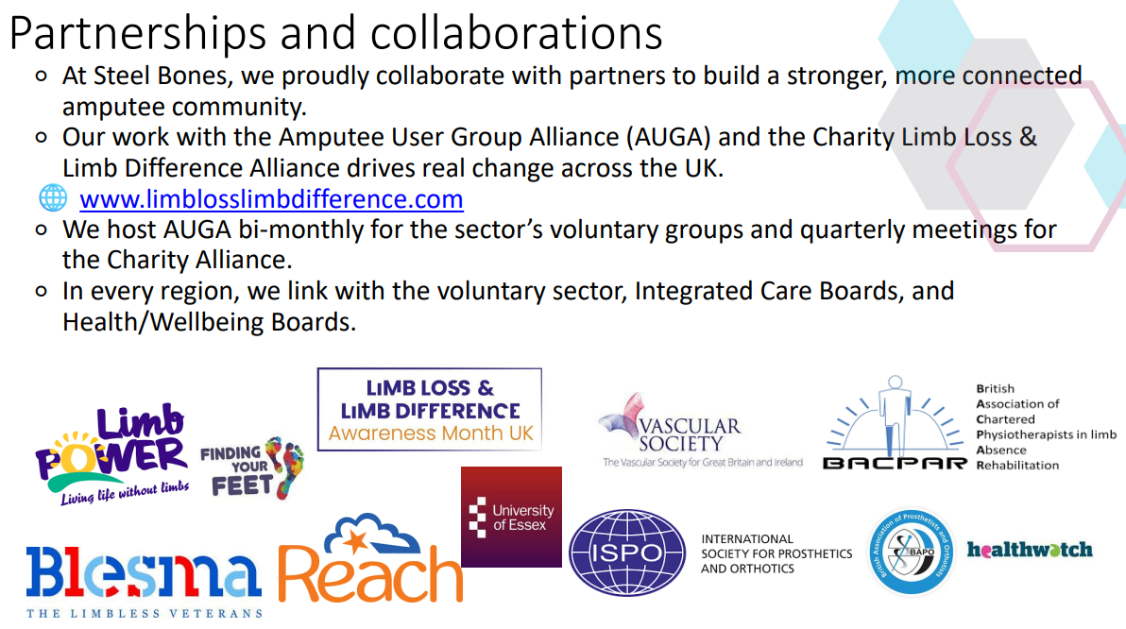
Steel Bones is:
Founding member of Amputee & Limb Difference Research Committee
Chair of Alliance of Limb Loss and Limb Difference Charities
Chair of a Network for Local volunteers running support groups across the country

Slide 7



Slide 8
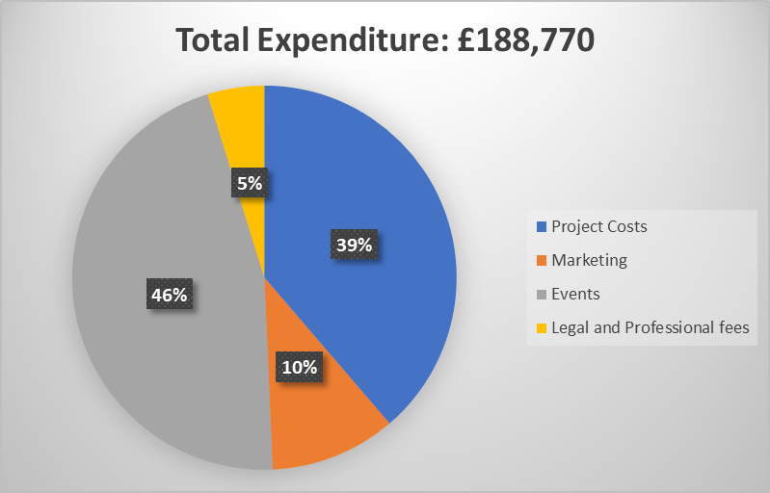

Slide 9


Slide 10

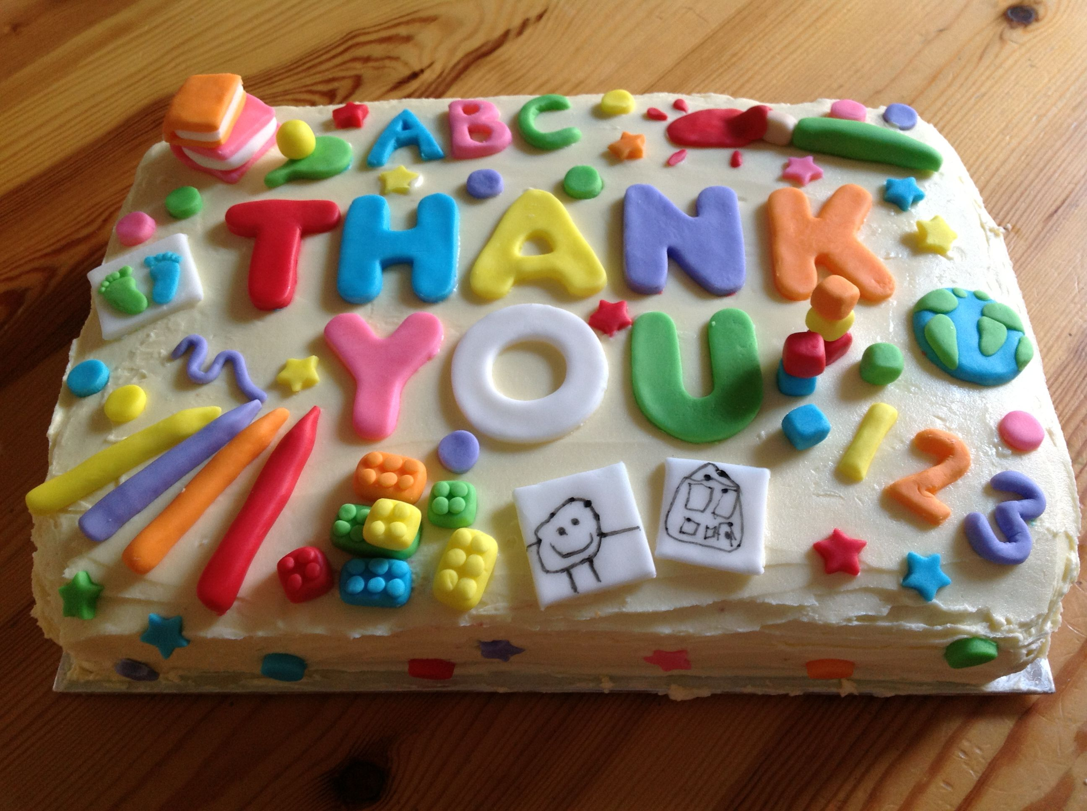

Slide 11



Slide 12
ANY OTHER BUSINESS
Thursday 4th December – 7pm – BINGO! In person, Newmarket Catholic Church – raising funds for Steel Bones
Sunday 7th December – 2-5pm – Christmas Party at The Beeches, Isleham. Please register here if you haven’t already - Steel Bones Christmas Party 2025 – Fill out form
Thursday 18th December – 7-8pm – Online Quiz for all Volunteers!
Expenses – any expense forms that you have will need to be submitted to finance@steelbone.co.uk by Friday 12th December
Steel Bones Phones – our phone line will be closing at 4pm on Tuesday 23rd December and reopen on Friday 2nd January 2026, at 10am

Slide 13


Slide 14


